Slide 1

MINOR PROJECT PRESENTATION
TITLE:
“WhiteRose”
(News Website)
Submitted by:
TUSHAR BHATT,
KARTIK VERMA,
KAVYA SINGH NAGI.
(From CSE DEPARTMENT 3rd YEAR)
INSTITUTE: NANHI PARI SEEMANT ENGINEERING INSTITUTE PITHORAGARH

Slide 2
ABSTRACT
"Step into the dynamic world of information with WhiteRose, your gateway to the latest, most compelling news stories curatedfrom the esteemed BBC network. Crafted as a culmination of ingenuity and technological finesse for a minor project, WhiteRose seamlessly integrates HTML, CSS, and Javascript to deliver an immersive user experience. Harnessing the power of the News API, WhiteRose offers real-time updates, ensuring you stay ahead in a fast-paced world.
With a sleek interface and intuitive functionalities, including a versatile search bar, WhiteRose empowers users to explore a plethora of topics, from global affairs to niche interests, all at their fingertips. Join us on a journey where every click unveils a new narrative, every scroll ignites curiosity, and every visit promises enlightenment. Welcome to WhiteRose, where information meets innovation."

Slide 3
INTRODUCTION
Welcome to the digital realm of innovation and information dissemination - where creativity meets technology to redefine the way we engage with news. This introduction serves as your exclusive invitation to explore WhiteRose, a captivating news website meticulously crafted as part of a minor project endeavor. Developed utilizing the dynamic trio of HTML, CSS, and Javascript, WhiteRose stands as a testament to the power of modern web development tools in shaping user experiences.
With a user-friendly interface designed to captivate and inspire, WhiteRose beckons users to embark on a journey of discovery. Equipped with a robust search bar feature, individuals can effortlessly navigate through a vast sea of news topics, tailored to their interests and preferences. Whether it's delving into breaking news headlines or exploring niche subjects, WhiteRose ensures that every visit is an enriching and immersive experience.
At the heart of WhiteRose lies a commitment to delivering real-time, curated news content sourced directly from the esteemed BBC network. Through seamless integration with the News API, users are empowered with up-to-the-minute updates on global events, trends, and stories that matter. But WhiteRose isn't just about information consumption - it's about empowerment and exploration.
Join us as we delve deeper into the intricacies of WhiteRose, where innovation, technology, and the pursuit of knowledge converge to shape the future of news consumption.

Slide 4
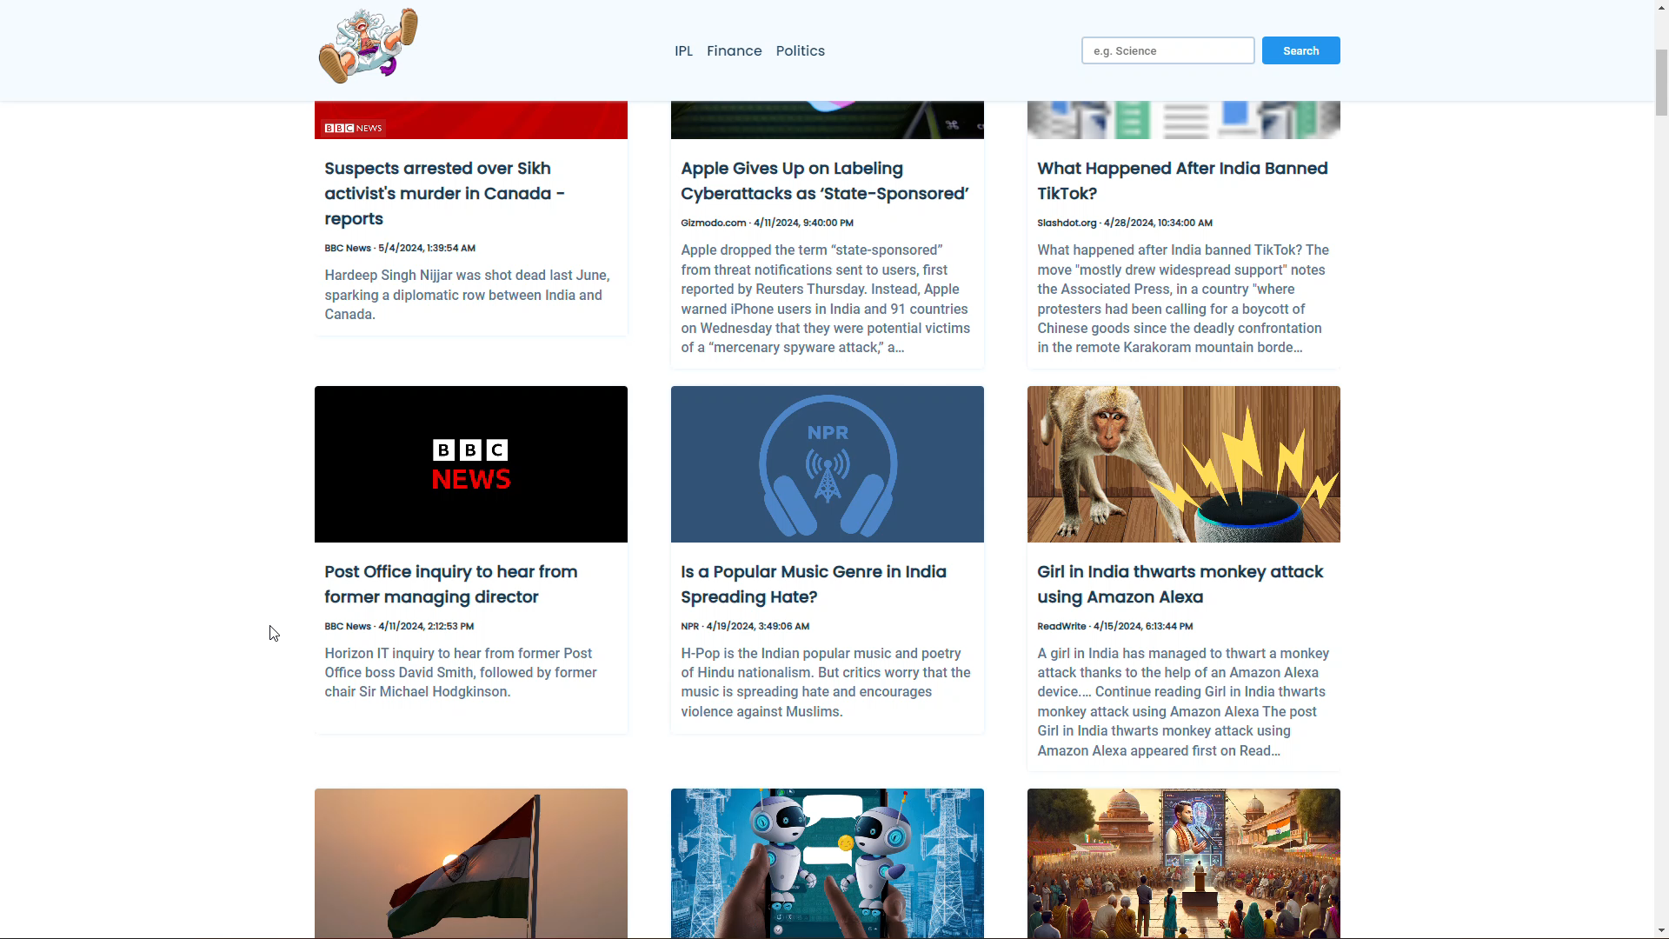

Slide 5
REQUIREMENT ANALYSIS AND SYSTEM SPECIFICATION
1. Project Objectives
• The primary objective of WhiteRose is to create a user-friendly platform for accessing live BBC news updates seamlessly.
• Target Audience: General users seeking reliable and up-to-date news information from diverse domains.
2. Functional Requirements:
• Live BBC News Integration: Real-time retrieval and display of news articles from the BBC network.
• Search Functionality: A robust search bar enabling users to find news articles based on specific keywords.
• Navigation Menus: Intuitive navigation menus for easy exploration of news categories and sections.
• User Authentication: Secure user authentication and account management functionalities.
3. Validation and Verification:
• Testing Strategy: Comprehensive testing of functionalities to ensure they meet specified requirements.
• Acceptance Criteria: Clear criteria for determining whether the implemented system fulfills the project objectives.

Slide 6
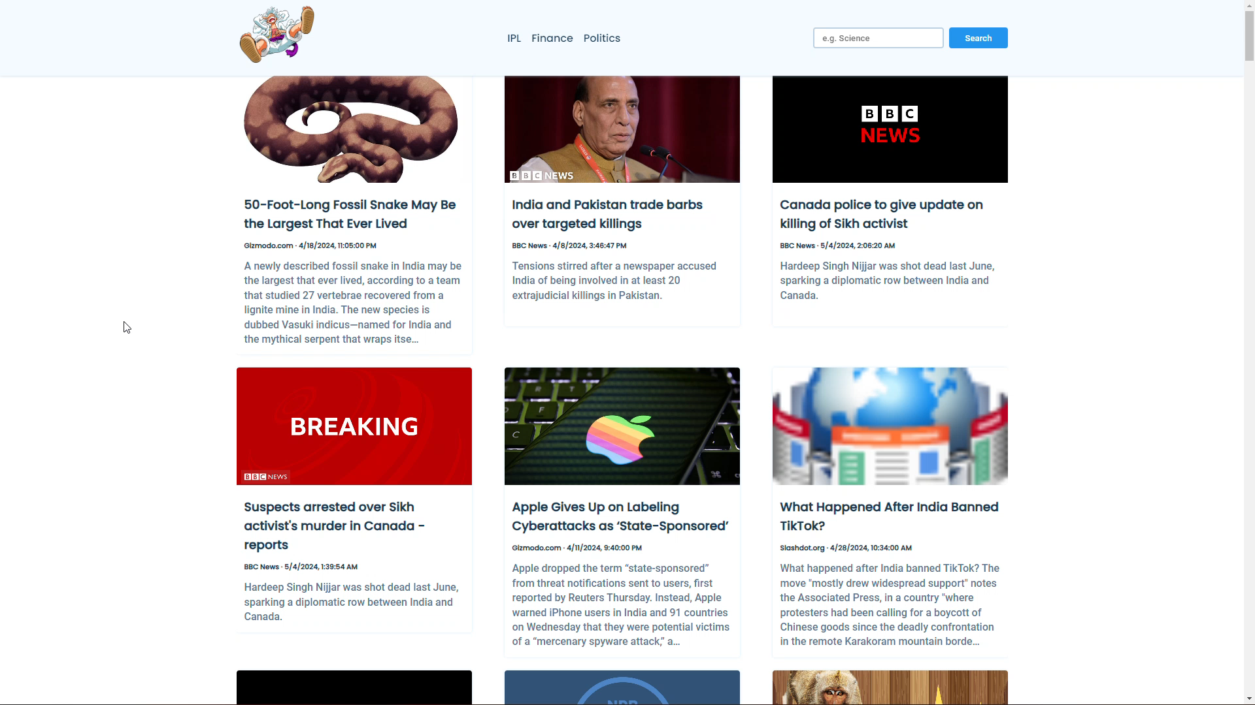

Slide 7
CONCLUSION & FUTURE SCOPE
In conclusion, the development and implementation of the whiterose news website mark a significant milestone in providing users with a seamless and immersive platform for accessing live BBC news updates. Through meticulous design, robust implementation, and thorough testing, whiterose has emerged as a reliable source of realtime information, offering users a user-friendly interface and intuitive features for navigating through diverse news topics.
In conclusion, the WhiteRose news website represents not only a successful implementation of a minor project but also a promising platform for delivering timely and relevant news content to users worldwide. By embracing innovation, user-centric design, and continuous improvement, WhiteRose is poised to become a leading destination for news consumption in the digital age.

Slide 8
REFERENCES/BIBLIOGRAPHY
1. MDN Web Docs. (n.d.). HTML: Hypertext Markup Language. Retrieved from https://developer. mozilla.org/en-US/docs/Web/HTML
2. MDN Web Docs. (n.d.). CSS: Cascading Style Sheets. Retrieved from https://developer. mozilla.org/en- US/docs/Web/CSS
3. MDN Web Docs. (n.d.). JavaScript. Retrieved from https://developer. mozilla.org/en- US/docs/Web/JavaScript
4. News API Documentation. (n.d.). Retrieved from https://newsapi.org/docs
5. BBC News. (n.d.). Retrieved from https://www.bbc.com/news
6. Nielsen Norman Group. (n.d.). Usability 101: Introduction to Usability. Retrieved from
https://www. nngroup.com/articles/usability-101-introduction-to-usability/
7. W3C. (n.d.). Web Content Accessibility Guidelines (WCAG) Overview. Retrieved from https://www.w3.org/WAI/standards-guidelines/wcag/
8. Google PageSpeedInsights. (n.d.). Retrieved from https://developers.google.com/speed/pagespeed/insights/

